Slide 1

APPLIED DATA SCIENCE PROJECT
CUDA 2209
Fees Dashboard Using
Python Streamlit
Presented By
Vadada Supreethi 211801380036
N Venkata Akhil 211801370093
T Tarun Kumar 211801370085
B Harshini 211801370027
B Harini 211801370026
K.Nikhil 211801370111
Guided By
Mr. Amit Kumar,
Assistant Professor,
Department of computer science and Engineering

Slide 2
OBJECTIVE
Centralization of Fee Management: Create a centralized platform for fee-related activities, consolidating disparate processes into a unified system to enhance efficiency and accessibility.
Enhanced Transparency: Improve transparency in fee management by providing real-time access to fee information, and upcoming due dates for students and administrators.
Security and Data Privacy: Implement robust security measures to safeguard sensitive user information, ensuring compliance with data privacy regulations and instilling user confidence in the system.
Interactive Fee Status Visualization: Utilized Streamlit to create interactive graphs and visualizations depicting students' fee statuses, including details on due fees, paid fees, and categorization by fee types such as academic fees, transport fees, hostel fees, etc.

Slide 3
INTRODUCTION
The Fee Dashboard project aims to revolutionize fee management processes through the implementation of an efficient web-based application.Prior to the implementation of the Fee Dashboard, fee management processes were manual and prone to delays. The project was initiated to address these challenges by centralizing and automating fee-related activities.
By addressing current inefficiencies and enhancing transparency, the Dynamic Fee Dashboard aims to streamline fee management processes, reduce administrative overhead, and improve the overall user experience for users and administrators alike.

Slide 4
SCOPE
The scope of the Dynamic Fee Dashboard project encompasses the development and implementation of a web-based application tailored for efficient fee management.
The project includes user registration, login/logout functionality, dashboards for users and administrators, robust search and filter capabilities, comprehensive reporting tools, and seamless integration with existing university systems.
The project aims to address current challenges related to manual fee management, providing a scalable and user-friendly solution that enhances transparency, reduces administrative overhead, and improves the overall fee management process.

Slide 5
FUNCTIONAL REQUIREMENTS
User Management:
1. Registration, login/logout functionality for administrators.
2. Secure handling of user credentials.
3. Role-based access control to ensure appropriate permissions.
Dashboard Views:
1. Personalized dashboard for administrators displaying fee-related data visualization.
2. Visualization of fee payment statuses, including paid, pending, and overdue fees.
3. Ability to filter and sort data based on various parameters such as course, semester, and student details.
4. Real-time updates to reflect changes in fee statuses and student information.

Slide 6
NON-FUNCTIONAL REQUIREMTS
Performance:
1. Response times and data loading times capped at optimal levels to ensure a seamless user experience.
2. Efficient handling of large datasets to maintain responsiveness.
Security:
1. Access control measures, including role-based permissions, to restrict unauthorized access.
Usability:
1. User-centric design principles applied to ensure clarity, simplicity, and ease of navigation.
Maintainability:
1. Adherence to coding standards and best practices to maintain a clear and organized codebase.
2.Detailed technical documentation provided for future reference and modifications.

Slide 7
REQUIREMENT SPECIFICATION
Hardware Requirements :
Windows OS.
Memory (RAM):8GB RAM.
Stable Network Connection.
Web browser for testing application.
Software Requirements :
Visual Studios.
HTML and CSS.
Python with Streamlit.

Slide 8

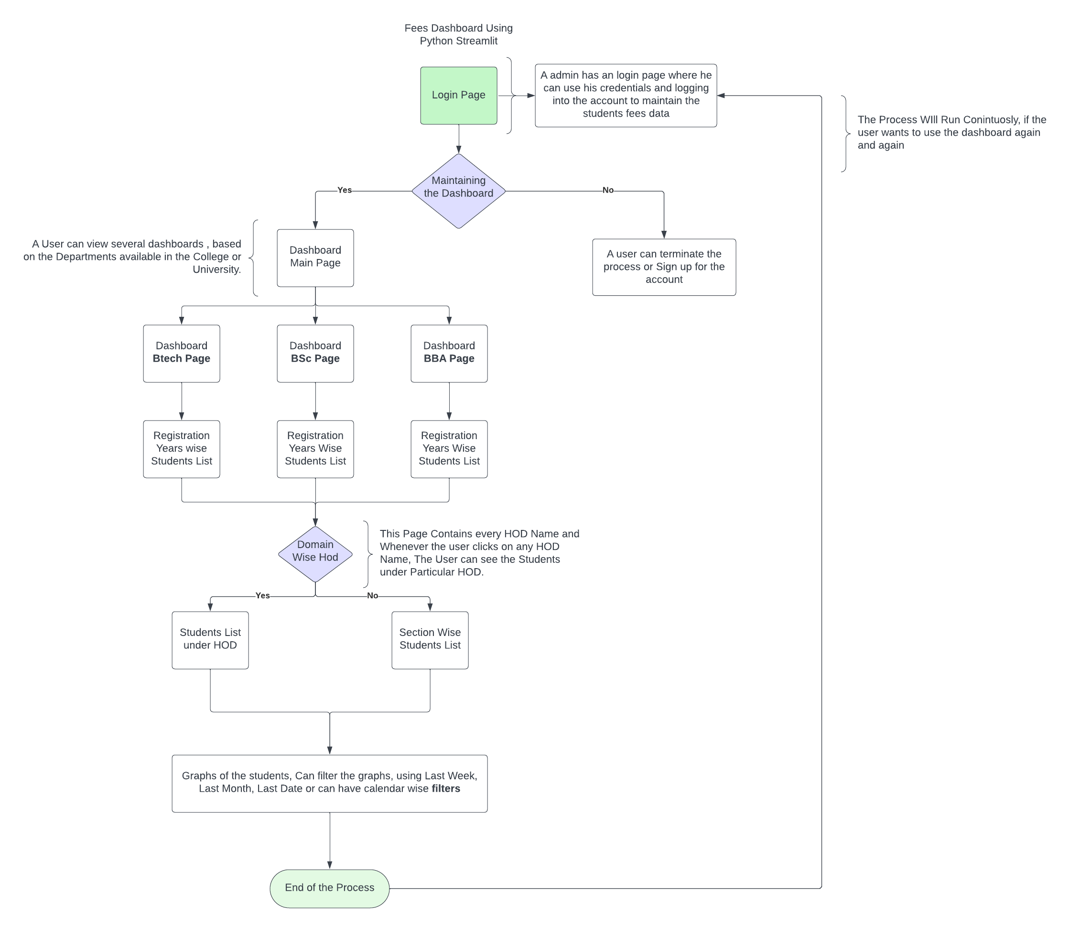
FLOW CHART

Slide 9
CONCLUSION
The Dynamic Fee Dashboard project has successfully addressed challenges in fee management through centralization and automation. By providing real-time fee information and personalized dashboards, transparency and efficiency have been greatly enhanced. Leveraging technologies like Streamlit for visualization ensures scalability and future adaptability. This project stands as a testament to innovation, user-centric design, and continuous improvement. Moving forward, ongoing enhancements will further optimize fee management processes, solidifying the project's impact and value for Centurion University. Gratitude is extended to all stakeholders and team members for their invaluable contributions to the project's success.

Slide 10
THANKYOU

